Slide 1
Supporting the human decision maker IBM Research and big data at the edge
Dr. Jürg von Känel
Associate Director IBM Research Australia

Slide 2
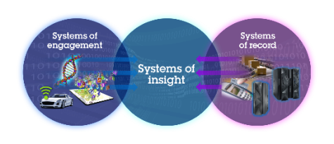
The recent evolution of the GTO: It’s all about Data
2012
2013
2014
Cloud
Mobile
Social
Internet of Things
Volume
Velocity
Variety
Veracity
Confluence of Social, Mobile, Cloud, Big Data, and Analytics
Systems of Insight
Data Transforming Industries
Do not distribute
Notes:
The signs are everywhere. To us, it’s clear that we live in a time of incredible opportunity and transformation, enabled by a convergence of technologies.
Cloud has become the growth engine for business. Data is the new basis for competitive advantage. And mobile and social engagement technologies promise stronger relationships, greater productivity, and higher brand value.

Slide 3
The recent evolution of the GTO: It’s all about Data
2012
2013
2014
2015
Cloud
Mobile
Social
Data
Internet of Things
Volume
Velocity
Variety
Veracity
Confluence of Social, Mobile, Cloud, Big Data, and Analytics
Systems of Insight
Data Transforming Industries
Data will disrupt entire industries
Do not distribute

Slide 4
Data is growing exponentially and demands
new approaches (technology and strategy)
44 zettabytes
You are here
unstructured data
structured data
2010
2020
Do not distribute

Slide 5
Data at the edge is changing how we look at data
90%
2X
Of data created over the last 10 years was never captured or analyzed
Rate of data creation compared to the expansion of bandwidth over the past decade
60%
By 2017
Of valuable sensory data loses value in milliseconds
The collective computing and storage capacity of smartphones will surpass all worldwide servers
Do not distribute

Slide 6
In moving from data to insights, the challenges of
managing data grow
Data begets data: context multiplier effect
Systems:
Learn, make
inferences,
create hypothesis
Do not distribute

Slide 7
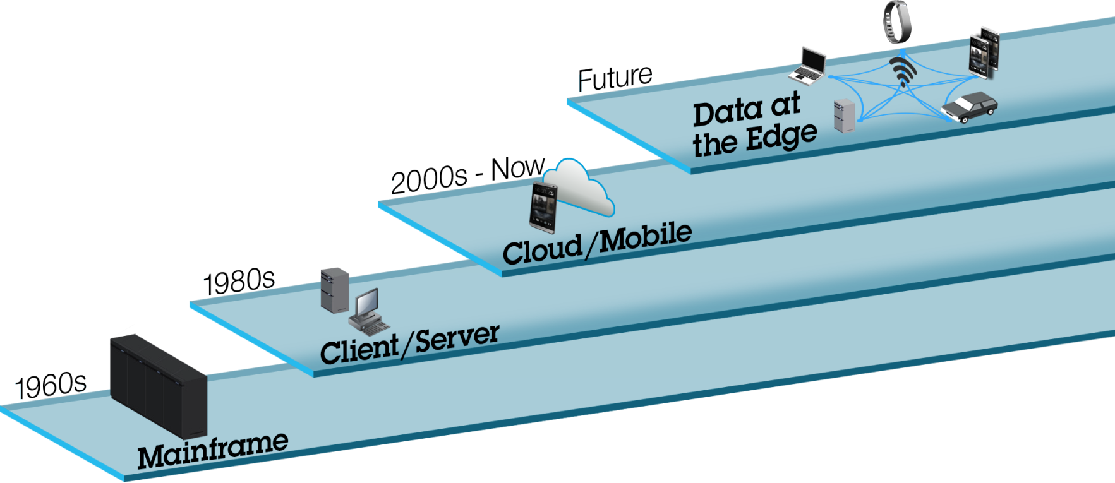
A new IT paradigm is emerging
Do not distribute

Slide 8
Data growth and gravity distorts and impacts every
Component of IT – and business
Do not distribute

Slide 9
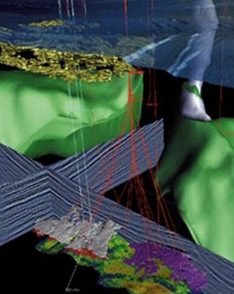
Data is the new basis of competitive value
Oil & Gas
Healthcare
Retail
Banking
Do not distribute

Slide 10
Rapid growth of exogenous data is transforming healthcare
Rapid growth of exogenous data is
transforming healthcare
Exogenous data
Influence on outcomes
1,100 Terabytes
Generated per lifetime
60%
Genomics data
30%
6 TB
Per lifetime
Clinical data
10%
0.4 TB
Per lifetime
Do not distribute

Slide 11
New payment insights through digitization of cash
Consumer volume
85% cash
15% non-cash
2.5 T
Transactions
Cash is the most used retail payment instrument*
Government &
Business volume
10% cash
90% non-cash
0.3 T
Transactions
Source: Master Card Advisors, 2013 report
* Source: http://www.frbsf.org/cash/publications/fed-notes/2014/april/cash-consumer-spending-payment-diary
Do not distribute

Slide 12
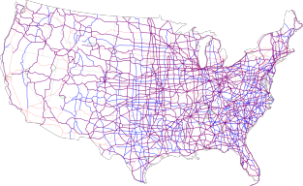
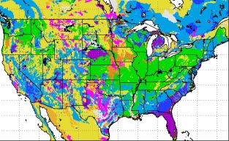
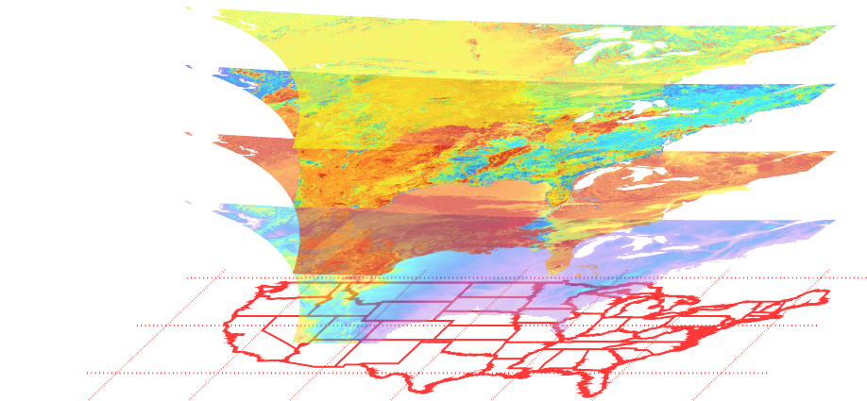
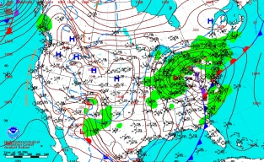
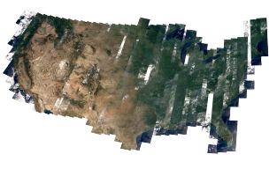
Analyzing open spatio-temporal data at scale
Illustrates the power of curation
Roads
Soil
Weather
Land
Un-curated
Diverse sources, resolutions, gaps, data types, update frequencies and uncertainty levels
Curated
Creates an integrated up-to-date view of layered spatio-temporal data with industry-specific analytics
Do not distribute

Slide 13
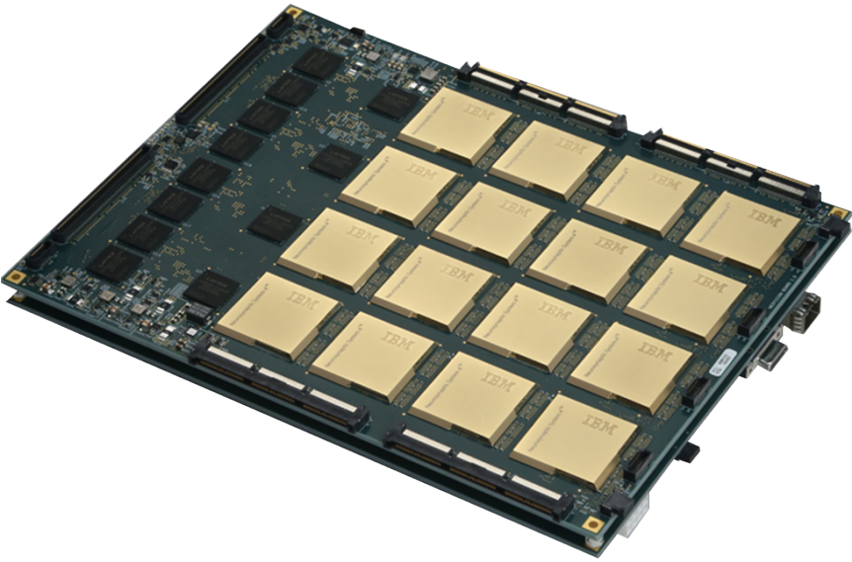
Brain-inspired systems will allow better analysis
of sensory data
Do not distribute

Slide 14
Human Accuracy
100%
Human Accuracy
Deep learning
Accuracy
Traditional approaches
Time
Do not distribute

Slide 15
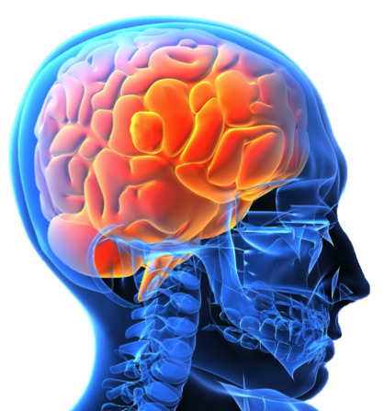
Human Accuracy
100 Billion Neurons
100%
Human Accuracy
Deep learning
Accuracy
Traditional approaches
Time
Do not distribute

Slide 16
Computer ‘brain power’
8 Million Watts
1.5 Million Processors
1500X Slower
Do not distribute

Slide 17
Human ‘brain power’
100 Trillion Synapses
100 Billion Neurons
Consuming only 20 Watts

Slide 18
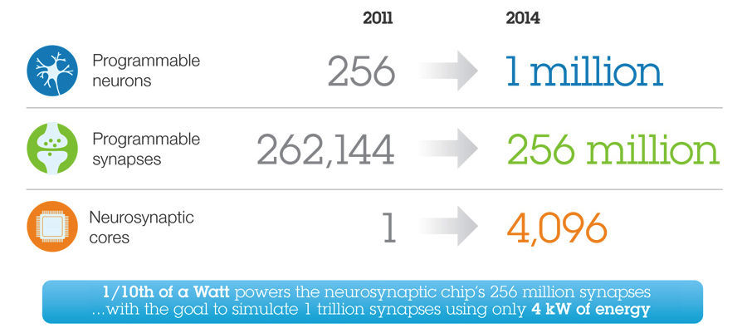
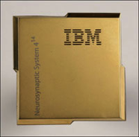
True North Chip

Slide 19
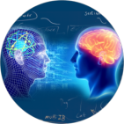
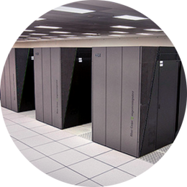
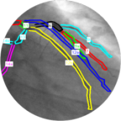
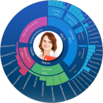
Leading in the next era of computer
Symbiotic Cognitive Platforms
Advanced Dialogue & Reasoning
Neurosynaptic
Brain-inspired
Computing
Physical Analytics
Hybrid Cloud
“Ad Hoc”
Systems
Exascale
Data-centric Systems
Curation at Scale
Personality
Analytics
Quantum
Computing
Advanced Image Recognition
Personalized Learning
0-18 months
18 months - 3 years
3-10+ years

Slide 20
IBM Research Global Technology Outlook Summary
2015
Data will disrupt entire industries and requires a new approach
Compute must move TO the data
Data creates optimal value when it is curated
New platforms will emerge at the edge
Businesses will benefit from higher quality insights and time-critical decisions
Brain-inspired systems will open entirely new possibilities for analyzing sensory data

Slide 21
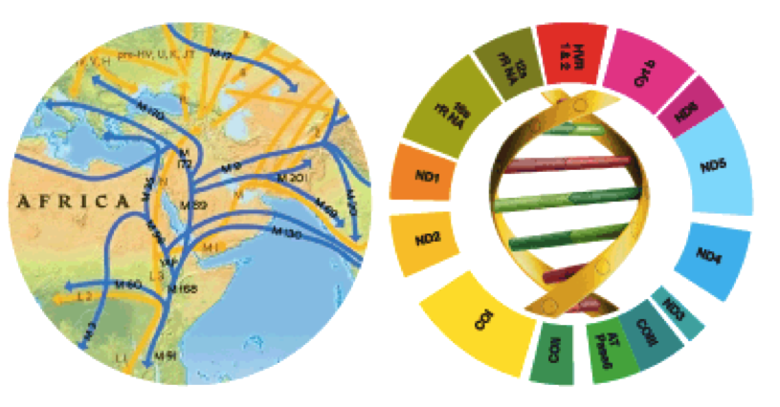
IBM Research
Famous for science,
vital to IBM

