Slide 1
Daeja ViewONE, Transition to IBM Support
Jeff Thompson – Enterprise Content Management ( ECM) WW Client Care Manager
July 2014
Document number

Slide 2
Enterprise Content Management (ECM) Client Care Team – We’re here to help!
Jeff Thompson – WW Client Care Manager
Claudia Dias – WW Client Care Representative
Manuela Buhse - WW Client Care Representative
Please feel free to contact us at iscare@us.ibm.com

Slide 3
Agenda for today's session:
Transition to IBM Support - Transfer of Support (TOS)
    Overview
General information
    Your ICN and site numbers
Service Requests
    Obtaining support online
    Additional support functions
    Help
Passport Advantage
    Obtaining support online
    Additional functions
    Help
Working with IBM Remote Technical Support
    Overview of support processes
    Escalation process
    Accelerated Value Program (AVP)
Additional Resources
    ECM Client Care team contact information
    Glossary of Terms
    Resource links

Slide 4

Transition to IBM Support
August
1
August 1, 2014 – Daeja completes the transition to IBM Support Tools and Processes.
We are committed to ensure smooth transition for all customers
Visit the Daeja support landing page http://www-01.ibm.com/software/ecm/daeja/support/ for the latest information
  Site provides step-by-step instructions in regard to “How To” Register for IBM Support
  Also includes this recorded TOS webinar and PowerPoint presentation for access to the many URL’s provided within.
Notes:
We’ll talk more about the transition on an upcoming slide……

Slide 5
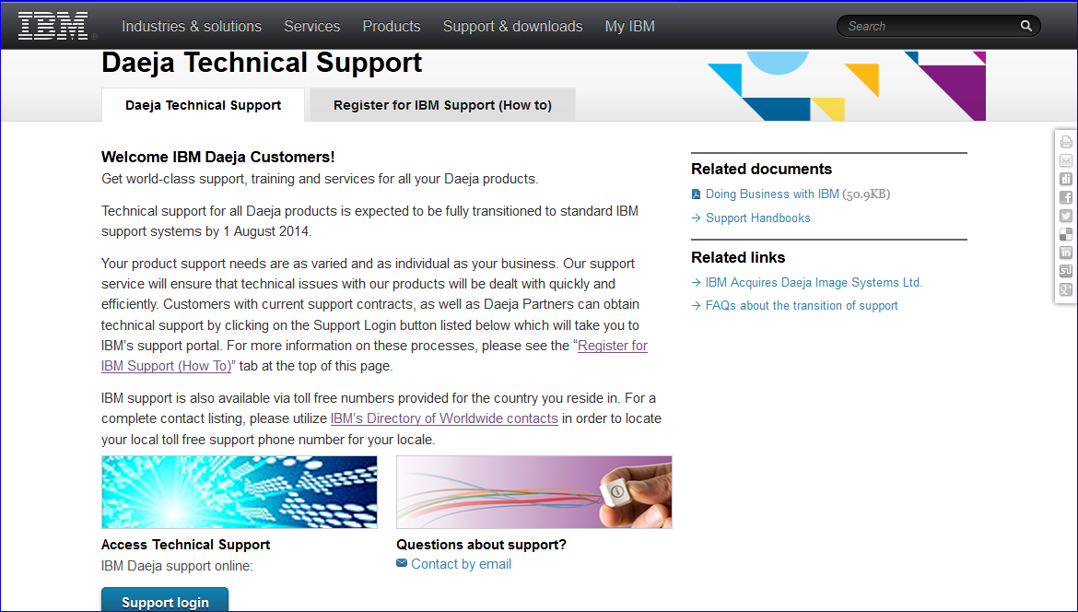
Register for IBM support (How To)

Slide 6
Transition FAQs
Q: What do I need to do as a Customer, to be ready for the IBM Process?
  A: Follow the remainder of this presentation or visit our IBM website for additional detail.
      Visit http://www-01.ibm.com/software/ecm/daeja/support/ for the latest information.
Q: Before IBM acquired Daeja Systems, I could raise issues via email. How do I get support now?
  A: IBM SW Support is only available to Customers with a current support contract. Customers with a
  current Daeja Maintenance Contract will be entitled to IBM support, support is available via two channels:
    Open an IBM Service Request (SR) via the IBM Support Portal
    Call 1-800-IBM-SERV for the US or visit IBM’s Directory of worldwide contacts. A Support call representative will open a Problem Management Record (PMR) on your behalf.
  Note: During the transition of the support process, April through July, 2014 IBM continued to honor e-mail initiated support requests via (Daejasup@us.ibm.com). Although, as of August 1, 2014 Customers requesting support via email will be redirected to the formal support channels defined above.
Q: I've never had a Maintenance Contract with Daeja, how do I get an IBM Support Contract?
  A: E-mail iscare@us.ibm.com to arrange follow up conversations.
6
Notes:
Here are a few very obvious questions……
6

Slide 7
So Lets Recap - How do I open a Support Case?
Product Version | As of April 1, 2014 | August 1, 2014
ViewONE 4.1 | E-Mail via Daejasup@us.ibm.com Online via the IBM Support Portal - SR tool. Via phone: WW: www.ibm.com/planetwide US: 800-IBM-SERV | Online via the IBM Support Portal - SR tool. Via phone: WW: www.ibm.com/planetwide US: 800-IBM-SERV
ViewONE 4.0.X | Via phone: WW: www.ibm.com/planetwide US: 800-IBM-SERV | Via phone: WW: www.ibm.com/planetwide US: 800-IBM-SERV Online via the IBM Support Portal.
ViewONE … 1.X 2.X 3.X | Via phone: US: 800-IBM-SERV WW: www.ibm.com/planetwide | Support no longer available for these defined versions. ViewONE 1.X, 2.X and 3.X , End Of Support (EOS) is as of July 1, 2014. These defined releases are no longer supported.
Notes:
This slide simply provides a cheat sheet for creating a Support Case through the transition.
Note: As we transition the process, IBM will honor email initiated support requests (DaejaSup@us.ibm.com). This is only until July 1, 2014. In the meantime, customers are expected to pursue a Support Contract and the entitled support it provides

Slide 8
How does the transition apply to MY products?
Important product lifecycle dates
GA
GA
IBM Supported – IBM Process
IBM Supported – IBM Process
IBM Supported – IBM Process
4.1
IBM Supported – IBM Process
4.1
April 4
April 4
April 4
April 4
April 4
April 4
April 4
April 4
July 1
July 1
July 1
July 1
July 1
July 1
July 1
July 1
Oct 1
Oct 1
Oct 1
Oct 1
Oct 1
Oct 1
Jan 1, 2015
Jan 1, 2015
Jan 1, 2015
Jan 1, 2015
4.0.x
4.0.x
Daeja Support Process
Transitional Support Process
EOS
IBM Supported – IBM Process
EOS
IBM Supported – IBM Process
April 4
April 4
July 1
July 1
Oct 1
Oct 1
July 1, 2015
July 1, 2015
3.x
3.x
EOS
Daeja Support Process
EOS
Transitional Support Process
July 1
July 1
2.x
2.x
Daeja Support Process
Transitional Support Process
EOS
EOS
July 1
July 1
1.x
1.x
Daeja Support Process
Transitional Support Process
EOS
EOS
July 1
July 1
IBM’s Product Lifecycle (PLC) page:
http://www-01.ibm.com/software/support/lifecycle/index_d.html
Sign up for: My Notifications and Product Lifecycle Information
8
Notes:
8

Slide 9
General information www.ibm.com
Welcome to IBM

Slide 10
What's an ICN and Site Number, and why are they important?
General information
All IBM agreements include an IBM Customer Number (ICN) and Site Number. These numbers correspond to your agreement/contract and are used to access many services included in your support contract.
    ICN is an identifier of your organization & company’s name
    - ICN is used to access Support
    Site Number is an identifier of your sales order processed for under agreement within an organization on the Passport Advantage Program.
    - A single ICN can have a single or many Site Numbers (different products, end-
    dates, support offering, etc)
    Site Number is used to access online content, including:
      - Software downloads
      - Transaction and Proof of Entitlement documentation
    Note: In the event you are not sure of your ICN and/or site number, ECM Client Care can assist. Please send an e-mail to iscare@us.ibm.com

Slide 11
IBM Welcome letter:
Site number and temporary password
General information
Location of your temporary passcode
Location of your Site Number
Location of your
IBM Customer Number

Slide 12
What is Passport Advantage (PA) and Service Request (SR)?
General information
Passport Advantage (PA)
  Location from which software is downloaded
  Access is managed by Primary Contact
  www.ibm.com/software/passportadvantage
Service Request Site (SR)
  Location where support issues (PMR*) are entered/viewed/updated online
  Access is managed by Site Technical Contact (STC) or a defined Administrator
  www.ibm.com/software/support
*PMR = Problem Management Report
Directory of worldwide contacts can be found at: http://www.ibm.com/planetwide/
12

Slide 13
Understanding the importance of your company’s defined “Contact lists”
General information
Each Site has six functional contacts identified in the Passport Advantage contract
We will discuss the two which deal with Support.
The Primary Contact has a key role in obtaining software product downloads.
Primary Contact / Primary Site Contact (PSC)
    Individual entering into contractual relationship with IBM
    Responsible for IBM Software and Services Online Tool for downloads through Passport Advantage (PA)
    Manages contact’s access to the PA website.
The Site Technical Contact has a key role in obtaining technical support.
Site Technical Contact (STC)
    Responsible for overall support compliance
    Manages user access to the online Service Request (SR) website.

Slide 14
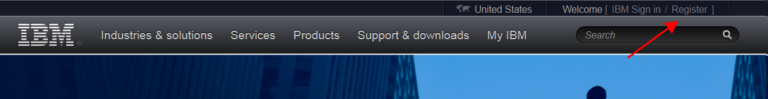
IBM ID – Why I need one
General information
An IBM ID is the driving credential to log into our online support services on ibm.com. Some IBM websites request you just login, while others request a one time “self nomination” against your ICN or Site Number.
In order to utilize these online services you must register for an IBM ID, also know as a WEB ID. A “Register” link is found on most webpages that require a login, although you can just go to www.ibm.com and select “Register” at the top right of our homepage.
Note: Establishing your IBM ID is the first step in setting IBM support
www.ibm.com

Slide 15
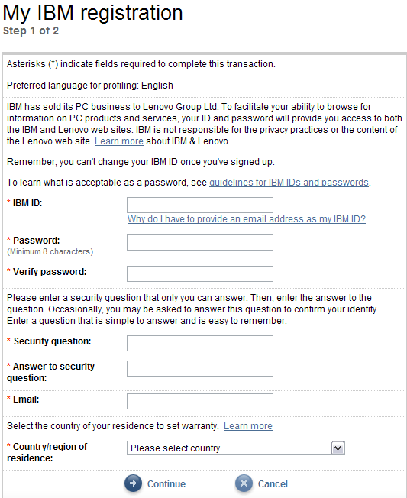
Basic IBM Registration
General information
Use your company email as your IBM ID for your IBM ID (WebID) and Email address
Choose your own password and enter it twice to verify
Specify your own security question and answer that you can remember!
Must specify your country
Notes:
As seen earlier for downloading your software, this is the basic IBM registration to get your IBM Web ID

Slide 16
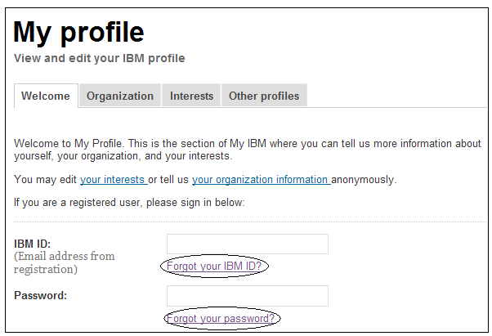
If you’ve forgotten your IBM ID or password
General information
Go to: https://www.ibm.com/account/myibm/profile.do?cc=us&lc=en
Click on Forgot your IBM ID? or Click on Forgot your password?
  Based on your country, email Enter IBM ID and follow steps
  or phone to obtain your IBM ID to request new password
www.ibm.com

Slide 17
Service Request site (SR) http://www.ibm.com/support/servicerequest/
Welcome to IBM

Slide 18
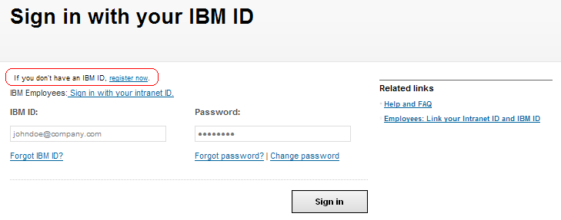
Support Registrations - Self nomination for Site Technical Contact (STC) and Users
Registering with Service Request site (SR):
Access SR at http://www.ibm.com/support/servicerequest/
Enter your IBM login ID and password. If you do not have a login ID, click the ‘Register Now’ link located just above the login box to create your login/password.
Step 1 Request access - Enter your IBM Customer Number (ICN), select the country/region, and click Submit
  If you do not know your ICN, please contact iscare@ibm.com for assistance.
Step 2 Verify email address - Click the Send verification email button. This will send you an email with a registration code.
Step 3 Enter registration code - Enter the registration code that was emailed to you into the Registration code field and click Submit.
Step 4 Registration success - Click Return back to my agreements for the status of your access request(s).

Slide 19
SR Access Definitions:
1- Site Technical Contact = STC (only 1 person for site)
Also known as STC, Primary Site Technical Contact and Primary STC; is only assigned for a Passport Advantage
agreement, and is the person at a customer's Site who is designated as the primary technical contact when IBM
software is purchased. The STC is responsible for assigning Administrator and Full Users to their agreements to
give them access to the Service Request (SR) tool. They also have the ability to manage relationships with
Business Partners to allow the partner to create and update service requests on their behalf.
2- Administrator = Technical Contact (9 people per site)
Also known as Secondary Site Technical Contact, TC or STC; there may be up to nine per support agreement. A
person at a customer's Site who is designated by the Site Technical Contact (STC), or IBM Administrator if no
STC is assigned. The Administrator is responsible for managing the list of authorized users allowed to access SR.
Only Passport Advantage agreements are required to have STC or Administrator. It is recommended but not
required for other support agreement types. An Administrator can also manage relationships with IBM Business
Partners.
3- Full = Authorized Callers/Users (unlimited number of people)
A person at a customer site who is designated by the Site Technical Contact (STC) and Administrator for SR to
open Service Requests (PMRs) and view all service requests for that customer site and support agreement.
There is generally no limit on the number of Full users per support agreement.
4- Reader = Authorized Reader (unlimited number of people)
A person at a customer site who is designated by the Site Technical Contact (STC) and Administrator for SR to
only view and read all Service Requests (PMRs) for that site or agreement. There is generally no limit on the
number of Readers per support agreement.
5- Basic = Provisional User (unlimited number of people)
A person at a customer site who haven't been approved by the Site Technical Contact yet. They have restricted
access. They can create and update PMRs and see only their own PMRs, but they can't see or update other
PMRs. Basic users don't have expiration date to be approved by STC and can stay as "Provisional" forever.
Notes:
After clicking Show or Update Below, note the alphabet – a bit confusing at first – clicking a specific letter will bring up users whose last name begins with that letter. Or, you can click “All”
You can change the status and/or the access level of any user. Click the “Add to a new agreement” to extend the access for this user.

Slide 20
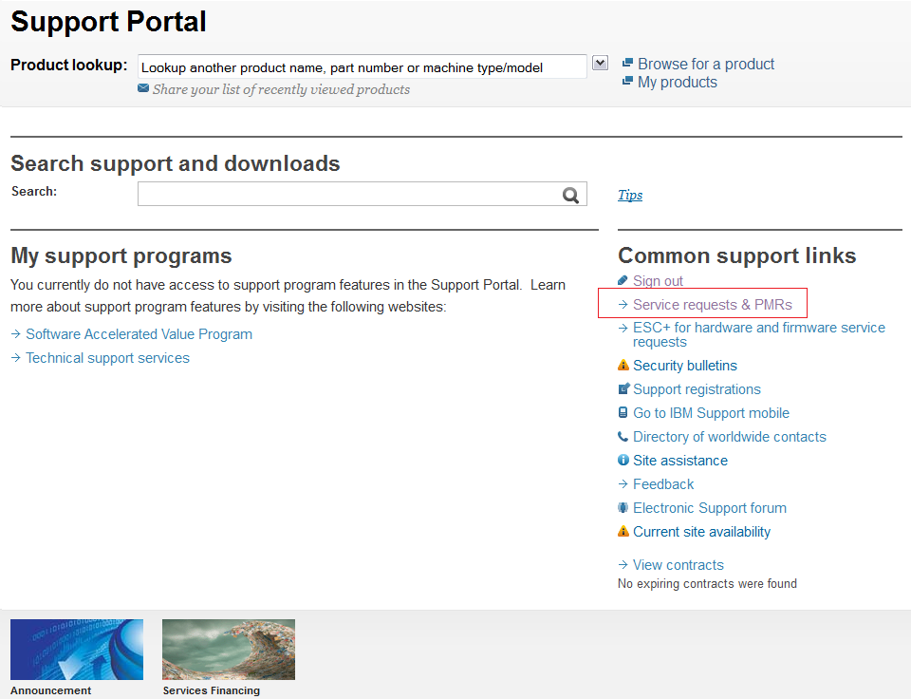
Support Home Page - https://ibm.com/support/

Slide 21
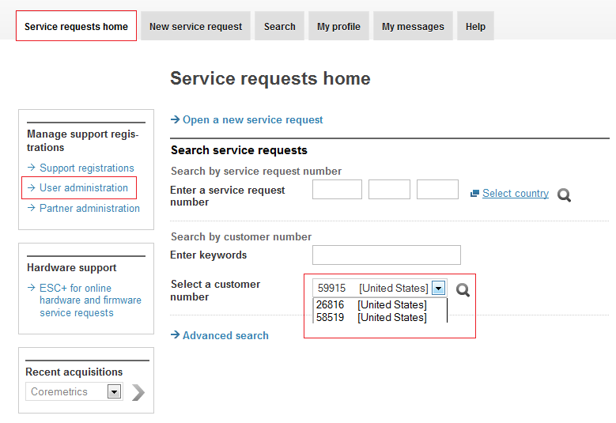
Service Request – User Administration
Notes:
If you are a Site Technical Contact or an Administrator, you will have the “User administration” and “Partner administration” menu options.
Choose Update to view and update existing user access.
Click the “Show or update list below” and then click the “Add a user to your agreements”.
Choose “Copy” if you need to copy all users from one ICN to another – this might happen when the Sales Transaction has created a new ICN and existing users should be enabled to the new ICN.
Choose “Auto Approval” to manage a list of email domains that will be auto approved for access to a specific ICN. You may also specify a list of email addresses to be active or specifically disabled from auto approval.
Choose “New Requests” to view any new requests that have been received and update the status of each request – approve or deny access and specify the access level.

Slide 22
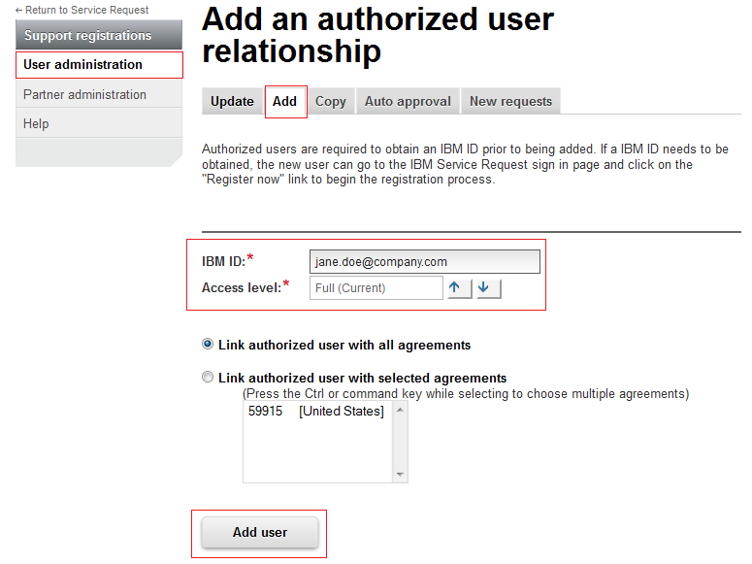

User Administration – Add additional user:
Notes:
Note that the user MUST already have an IBM Web ID before the administrator can associate that user to the ICN for Service Request Submission.
Note the error you will receive if that user has NOT registered his email address.
You have the option to associate the user to all the agreements or to selected agreements.

Slide 23
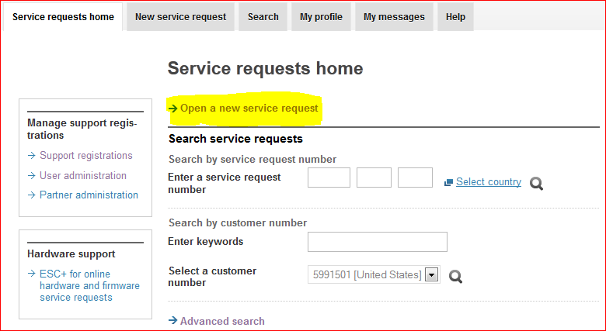

Service Request – Open a new Service Request
Notes:
If you are a Site Technical Contact or an Administrator, you will have the “User administration” and “Partner administration” menu options.
Choose Update to view and update existing user access.
Click the “Show or update list below” and then click the “Add a user to your agreements”.
Choose “Copy” if you need to copy all users from one ICN to another – this might happen when the Sales Transaction has created a new ICN and existing users should be enabled to the new ICN.
Choose “Auto Approval” to manage a list of email domains that will be auto approved for access to a specific ICN. You may also specify a list of email addresses to be active or specifically disabled from auto approval.
Choose “New Requests” to view any new requests that have been received and update the status of each request – approve or deny access and specify the access level.

Slide 24
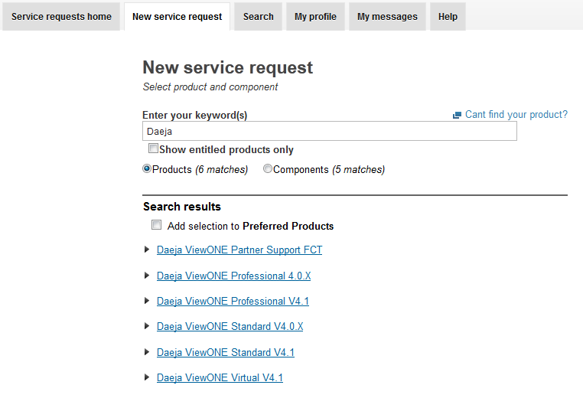
Opening a service request (SR)
Notes:
You will be taken to the “My Agreements” page. (Note the menu change on the left of the page as you are now in the “Service Request” application). Service Request access is associate with your IBM Customer Number. You may have multiples. At the bottom of this page, you will see your current access
As mentioned earlier, to register for the Service Request submission, you must have your IBM Customer Number.
Choose the default “By customer” option and specify your IBM Customer Number and your Country.
The “By machine type and serial number” option is used to request Hardware Support only. Registering in this way will not allow you to submit Service Requests for Software Products.
If the Site Technical contact has enabled your email domain to have access, you will immediately be enabled at the level specified by your administrator. If not, your administrators will be notified of your request. You can also request to a higher access level, which will send an email to your administrators.

Slide 25
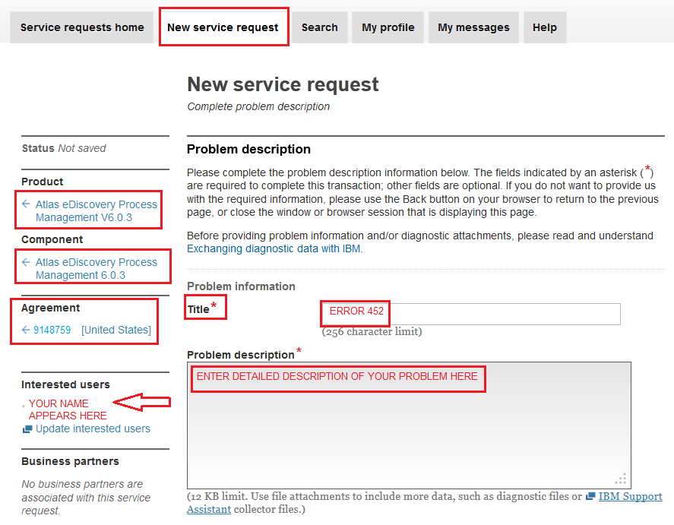


How to open a new service request - Title and Problem description
Notes:
To open a new Service Request, click the menu item.
The process of opening a service request is standard – specifying the product, verifying your contact information, defining and then submitting the problem.
Click the “Show entitled products” – you will be able to check a box to have them included in your “Preferred Products” for subsequent submissions.
“Entitled Products” are the products where you have a current Support Contract.
NOTE: If you uncheck the box and choose a product that is NOT an “Entitled product” for your account, processing the Service Request will be first directed to a separate department for entitlement verification. There could be significant delays – it is strongly suggested that you do NOT use this except to submit the problem where you are not seeing a product you expect to see and want someone to look at the entitlement issue.

Slide 26
Technical Information to provide
Provide as much specific information about the technical problem as possible.
  – Version and patch levels of IBM software, database, JDBC drivers, operating system
  – New project, test or production ?
  – What has changed ?
  – Can the problem be recreated? If so, provide details of how to reproduce the issue.

Slide 27
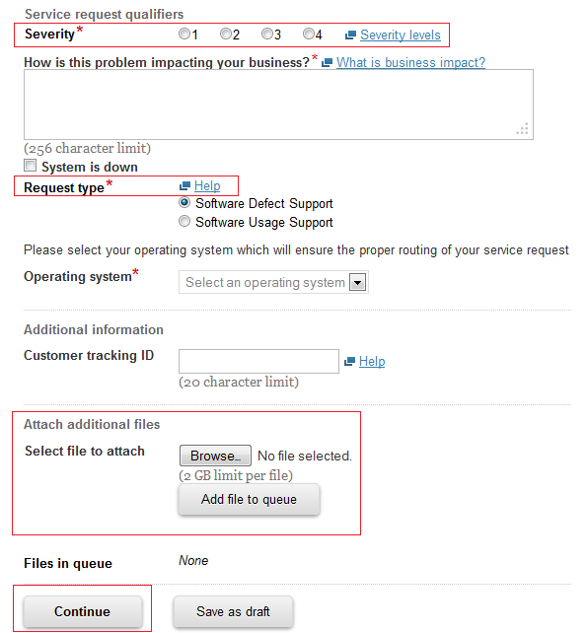
How to open a new service request – continued…
Notes:
Continue with the impact to your business, the type of request, your operating system. You can also specify a tracking number you might be using in your own internal systems for reference. And, you can attach files that demonstrate the problem or screen shots or log files with error messages.
Click submit to submit the issue to a Technical Support Specialist – you can also “Save as a draft” – if you’re working on a particular product and operating system that will enable you to quickly submit additional questions in the future.
After clicking “Continue”, you will be asked to verify your contact information, set your contact preference and update your notification preferences. If your contact information is incomplete, remember to use the “My Profile” link to update it and save time in the future.
You will also be able to add additional “interested users” who should receive updates on this Service Request.

Slide 28
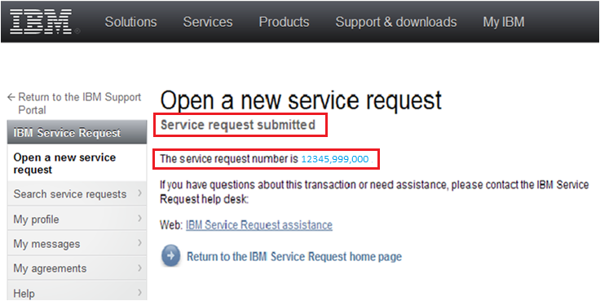
How to open a new service request – PMR submission and request number
Notes:
After clicking the “Submit” button on the contact verification form, a Service Request number will be assigned. You will also receive an email with a link that will take you directly to your Service Request where you can view status and updates from the Support Specialist and submit additional information regarding this Service Request.

Slide 29
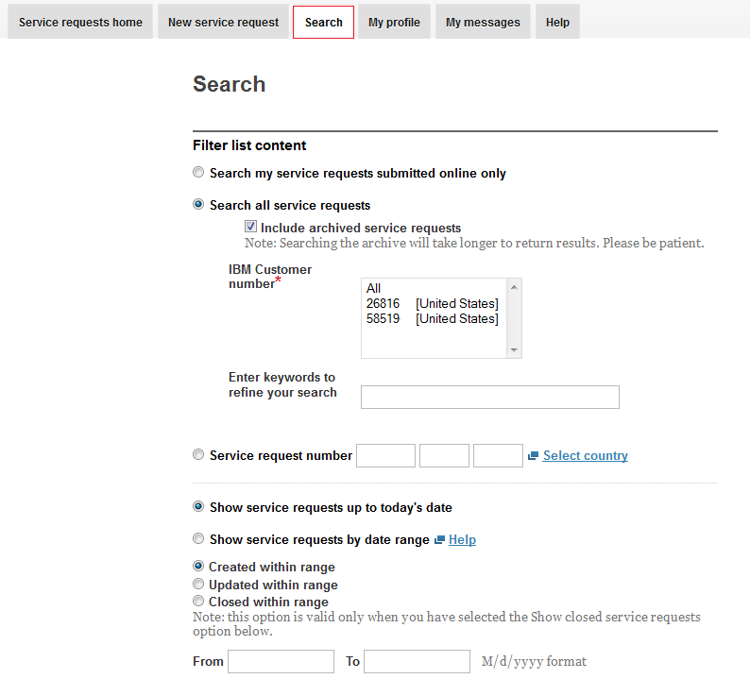

How to search and view service requests:
Once you search, select a specific PMR in order to view or update the PMR
Notes:
Returning to the Service Request portion of the Support Portal will enable you to see the list of Service Requests. Click the highlighted Service Request number to open the Service Request and view communications.

Slide 30
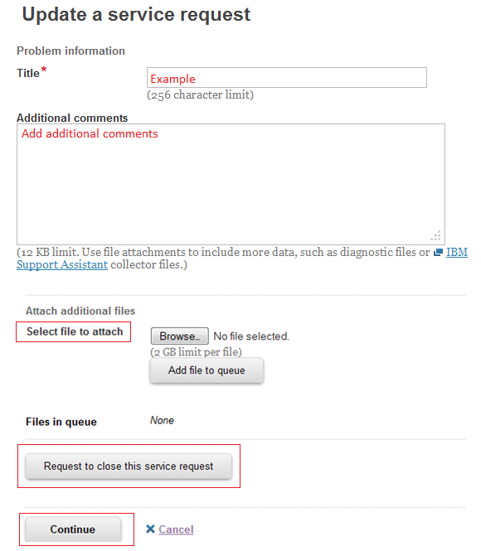
How to update service requests:
Notes:
When you open the Service Request, you will be able to add comments, attach additional files and see the history of the correspondence on the Service Request at the bottom of the page – click the “Service request update history” to reverse the order of the comments.

Slide 31
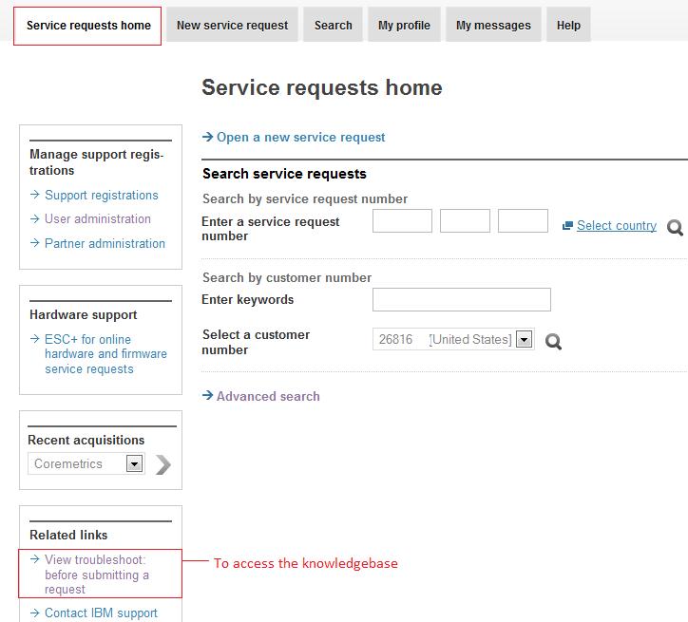
Additional Support Functions - Support Knowledgebase access from Service requests home page:

Slide 32
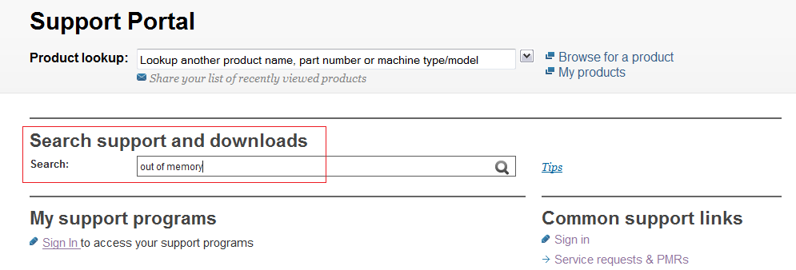
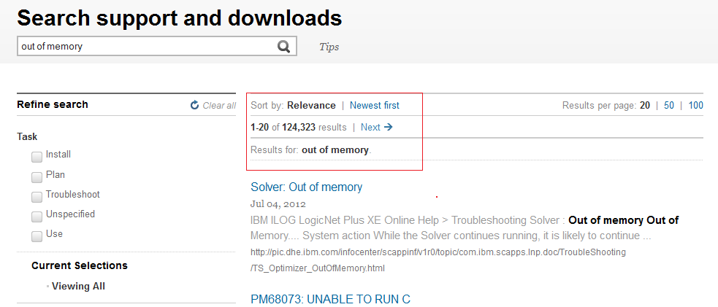
Additional Support Functions - Support Knowledgebase
To access from the Support Portal login page, simply enter information into search field:
Results will be returned by Relevance or by Newest first – your choice:

Slide 33
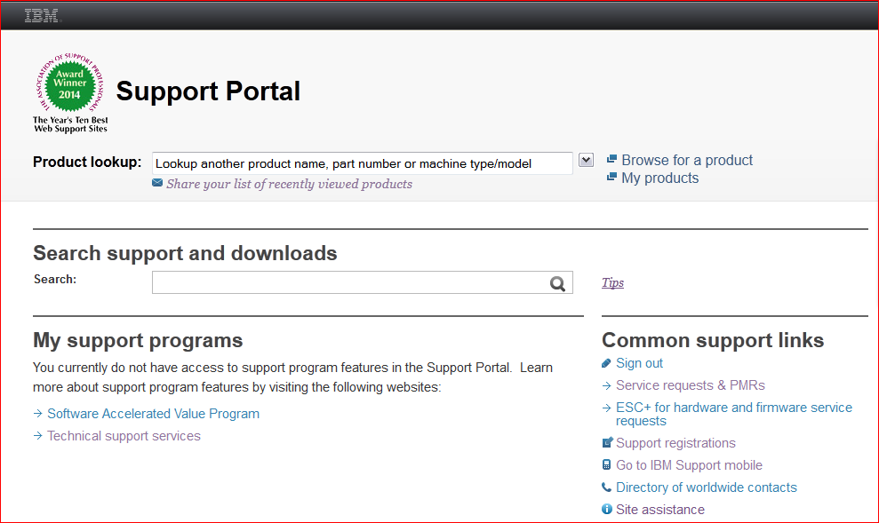
Support Knowledgebase – search via the IBM Support Portal https://ibm.com/support/

Slide 34
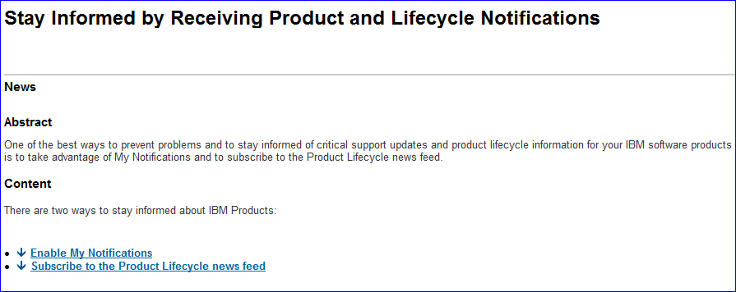
Additional Support Functions – Subscribe to product support notifications and product lifecycle information
Maintain your products and stay informed
  Receive updates about product news, fixes, technotes and more with My Notifications and Product Lifecycle Information
Download fixes using Fix Central
Connect with support through Social Media and other online resources
Share, collaborate and connect with other users using the IBM Client Success Essentials Community

Slide 35
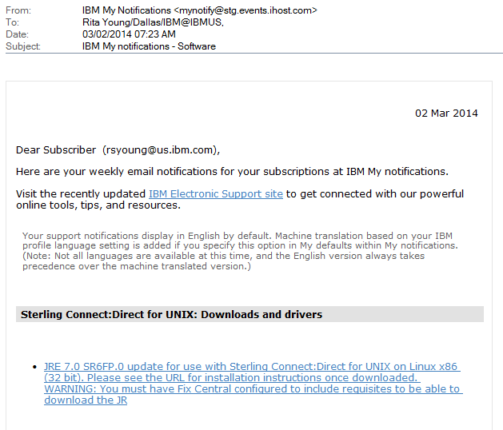
Support Notifications example:

Slide 36
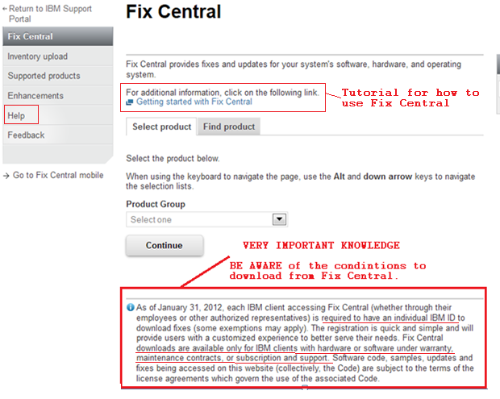
Additional Support Functions - Fix Central Website: http://www.ibm.com/support/fixcentral/
Current Releases will always be posted on the Passport Advantage site while all Fix Packs and Patches (for your current installation) will be housed on our Fix Central website.

Slide 37
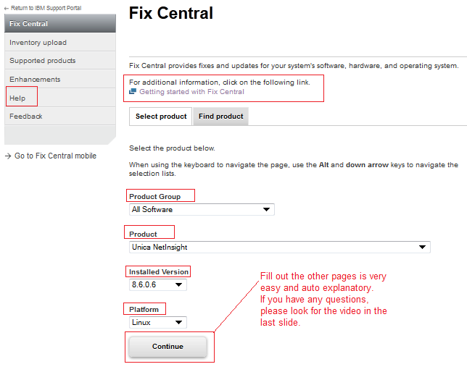
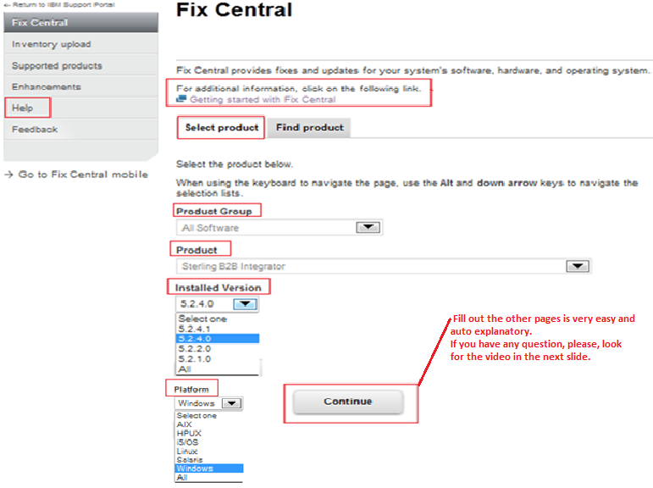
Additional Support Functions - Fix Central Website
Choosing your Fix Packs and Patches:

Slide 38
How to obtain Service Request Help
SR Help Desk: Please complete the SR Help Desk Form. You will receive an automated email that contains your ticket number. If you would like add attachments (such as screen shots) to your help desk ticket, please reply to the automated email and include your attachments. This team doesn’t have phone support.
SR Help information: https://www-946.ibm.com/sr/help/index.html
ECM World Wide Client Care Support Team: should you have any questions or are not receiving a response through other avenues, just know you can contact us at any time and someone will contact you during local business hours at: iscare@us.ibm.com
Contracts and maintenance issue: http://www-304.ibm.com/support/operations/us/en/contracts?lnk=msdCS-cagr-usen
Directory of worldwide contacts: opening PMR by phone at http://www.ibm.com/planetwide/
Videos:
IBM Electronic Support - http://www.youtube.com/channel/UCqaYCdZwPqkU05X-xUiG7lw
Glossary of Technical Support Documents: http://www.youtube.com/watch?v=_TB9zxajGJc&feature=autoplay&list=ULeg0y942dHYg&index=10&playnext=1
- How to Obtain an IBM User ID: https://www304.ibm.com/connections/wikis/home?lang=enus#!/wiki/W5d5c76e66242_4f86_80e4_12a9e0eefb4b/page/IBM%20Client%20Self-Assist%20Support%20%28CSA%29%20Help%20%26%20Resources
IBM Service Request streamlined problem submission process: http://publib.boulder.ibm.com/infocenter/ieduasst/imv1r0/index.jsp?topic=/com.ibm.iea.selfassist/selfassist/1.0/work/SRv25/SRv25.html
- Using IBM Service Request to review PMRs from the web: http://publib.boulder.ibm.com/infocenter/ieduasst/imv1r0/index.jsp?topic=/com.ibm.iea.selfassist/selfassist/1.0/work/UsingSRToReviewPMRsV25/UsingSRToReviewPMRsV25.html
- Mobile - Using IBM Service Request on your mobile device: http://www.youtube.com/watch?v=3oThsXLvgLs&feature=youtu.be
- Fix Central Tutorial: http://publib.boulder.ibm.com/infocenter/ieduasst/imv1r0/index.jsp?topic=/com.ibm.iea.selfassist/selfassist/1.0/download/FixCentralSWG/FixCentralSWG.html

Slide 39
Passport Advantage www.ibm.com/software/passportadvantage
Welcome to IBM

Slide 40
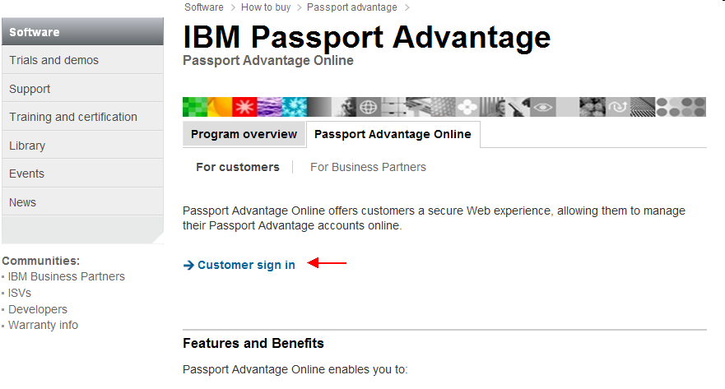
Passport Advantage
Self Nomination
Passport Advantatge
First time Login to the Passport Advantage website with your WebID
www.ibm.com/software/passportadvantage

Slide 41
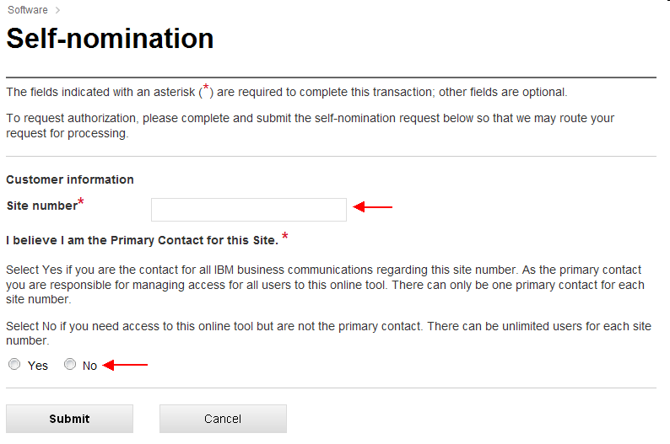
Passport Advantage
Self Nomination
Passport Advantage
Add your Site Number and choose the appropriate Yes / No Radio Button and Submit
If prompted for a Temporary Passcode (your Primary Contact would have received it in your Welcome Letter)
In order for our automated email feature to be initiated (which notifies the Passport Advantage Primary Contact that someone is requesting access) the PA Primary MUST first be associated (and approved) to their respective contractual numbers. If this has not occurred, then ALL user requests CANNOT be approved.

Slide 42
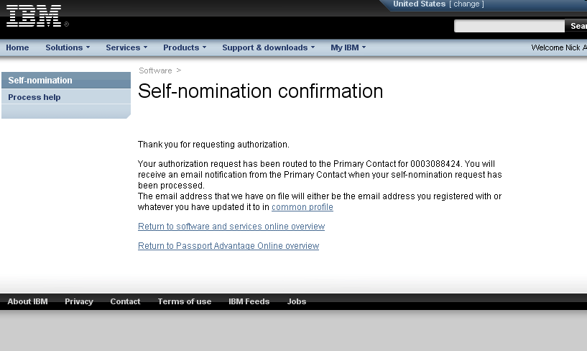
Passport Advantage
Self Nomination
Passport Advantage
A Confirmation Page will appear stating your request will be sent to the PA Primary for verification and approval. If you selected YES that you are the Primary, then your request will be sent to the eCustomer Care Team for validation. You will receive an email from them once it has been processed.
https://www-112.ibm.com/software/howtobuy/softwareandservices

Slide 43
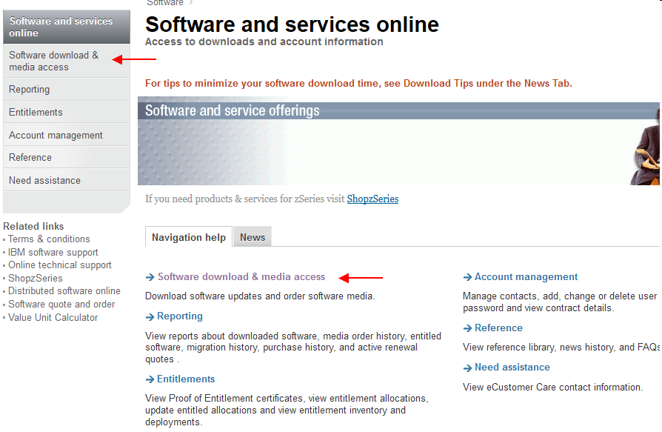
Passport Advantage
Accessing Current Releases
Once your Self Nomination has been approved, you will now be able to access your Entitled Software.
Log into the Passport Advantage Site and you will land on the ‘Software and Services Online’ home page.
Select ‘Software Download & Media Access’

Slide 44
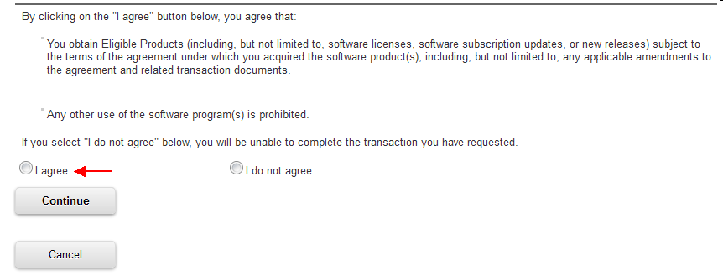
Passport Advantage
Accessing Current Releases
Select ‘I Agree’ to Terms

Slide 45
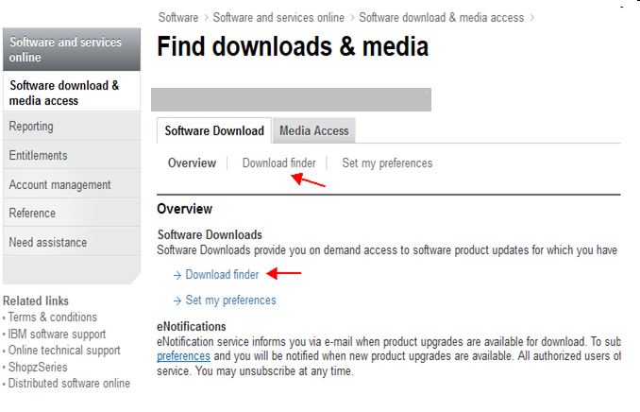
Passport Advantage
Accessing Current Releases
Select ‘Download Finder’

Slide 46
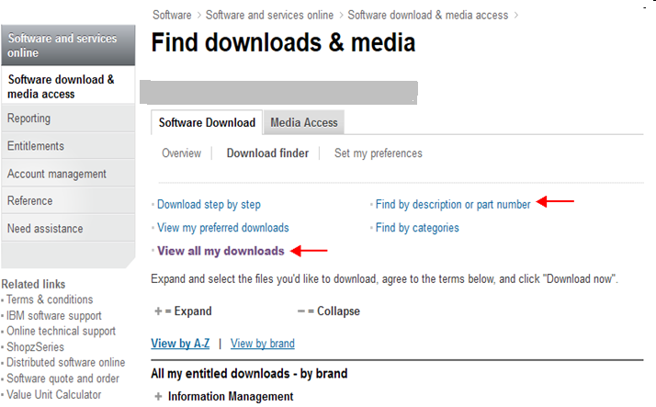
Passport Advantage
Accessing Current Releases
Select ‘View all my downloads’ or use the ‘Find By’ options to display Entitled Software

Slide 47
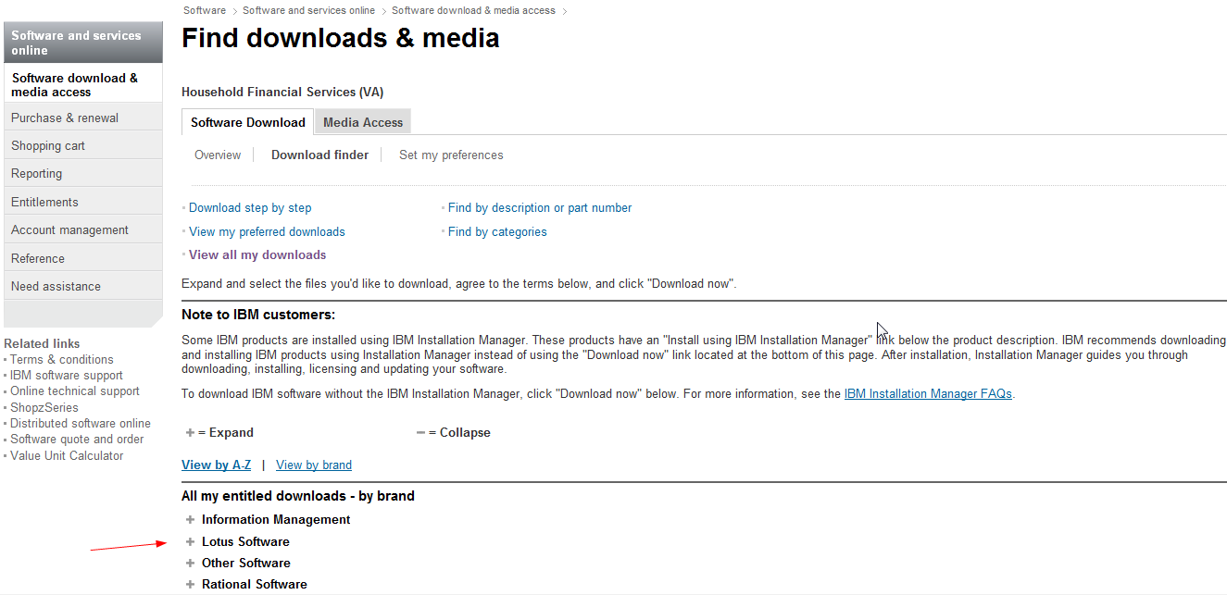
Passport Advantage
Accessing Current Releases
Expand the appropriate brand to display your Entitled Software
47

Slide 48
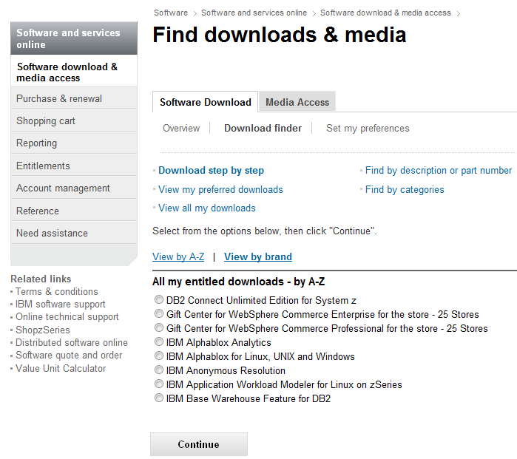
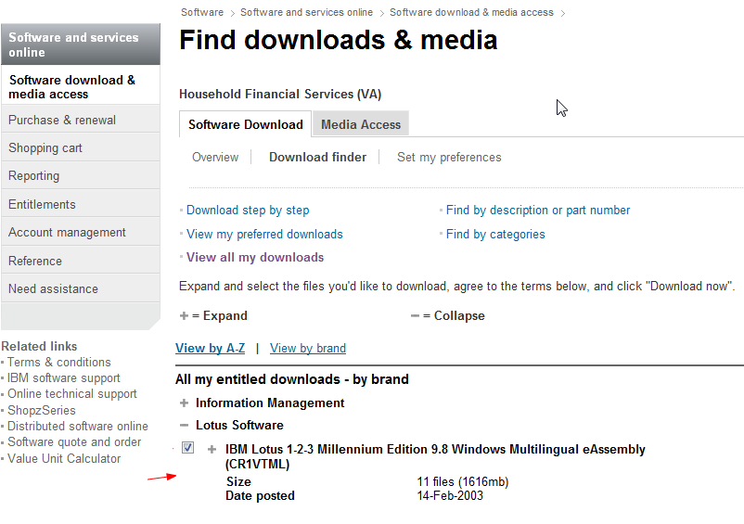
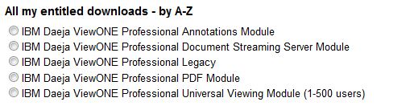
Passport Advantage Website
Accessing Current Releases
Scroll down to locate your desired product, check the box to the left of the product or expand the suite to download a particular component.

Slide 49
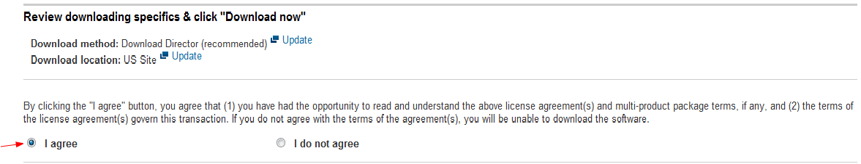
Passport Advantage
Accessing Current Releases
Scroll to the bottom of the page and agree to additional terms. Then select Download now!
49

Slide 50
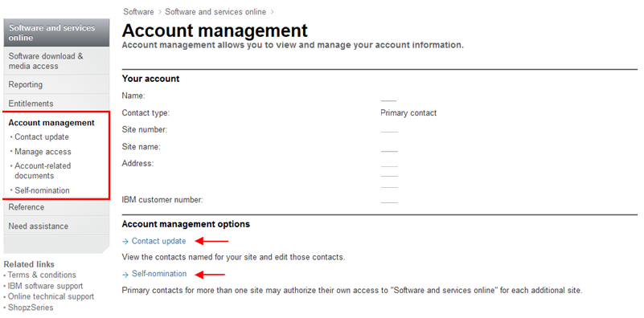
User Management
The Primary Contact has the administration capabilities to add / remove and alter access levels to the Passport Advantage site. These functions are only available after the Primary has self nominated to a site number and has been approved by the eCustomer Care Team.
Once access has been established, the Primary contact can now use the Account Management functions.
50

Slide 51
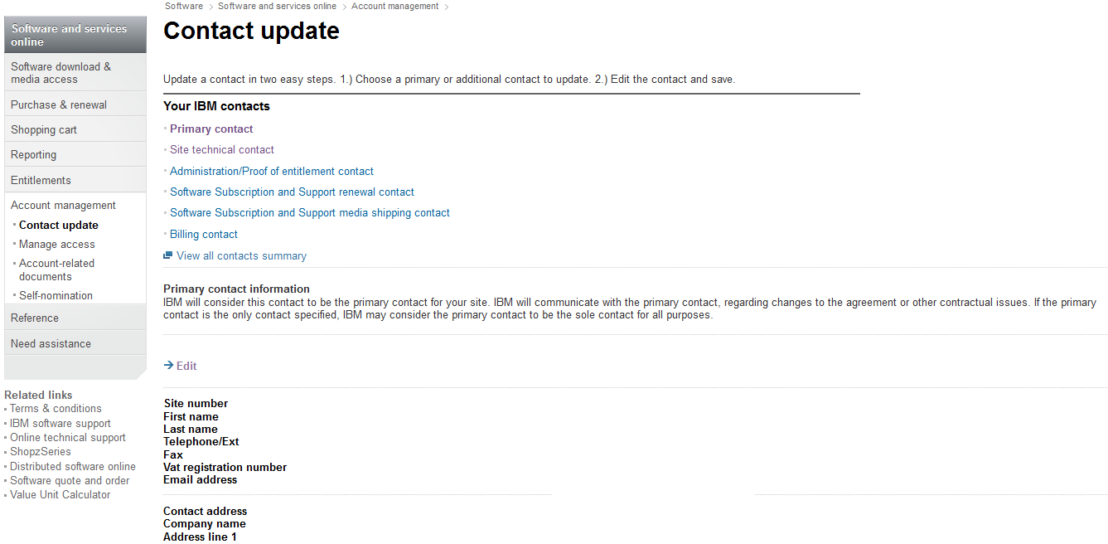
User Management
How to change contacts in Passport Advantage agreement

Slide 52
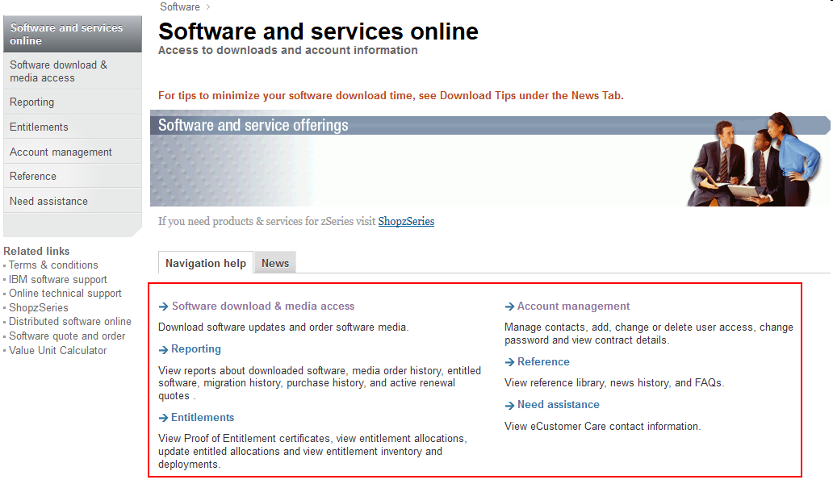
Additional Passport Advantage Functions
You will notice after logging into the Passport Advantage site that there are a number of other functions available. This includes Proof of Entitlement certificates and Reporting tools.
52

Slide 53
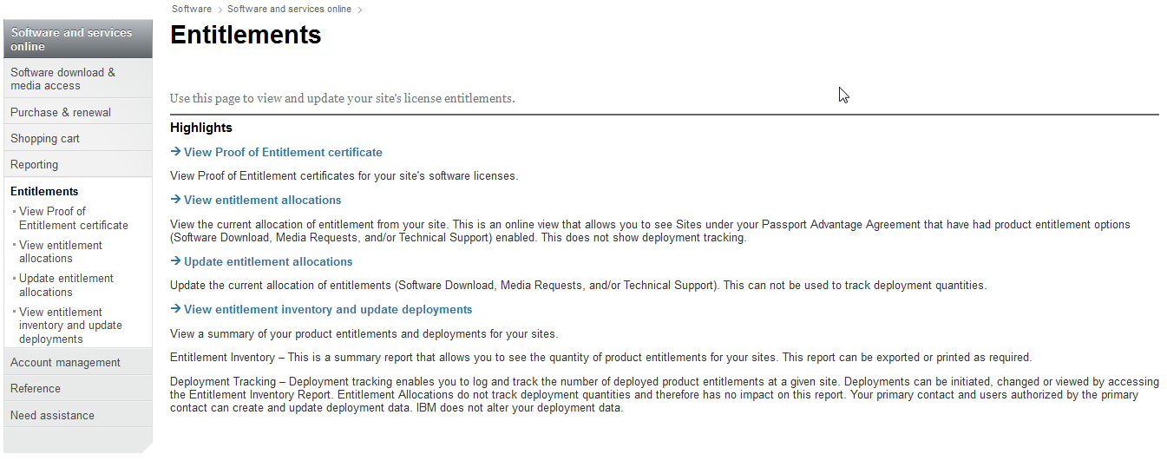
Entitlements
Select Entitlements. You can Manage Entitlements and view Proof of Entitlement Certificates.

Slide 54
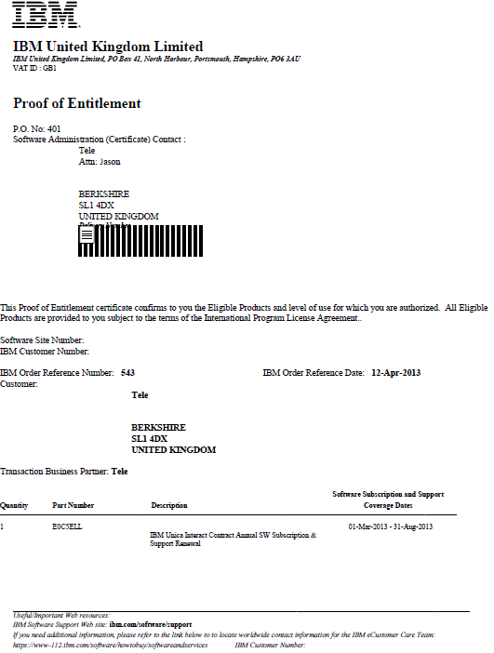
Proof of Entitlement example:

Slide 55
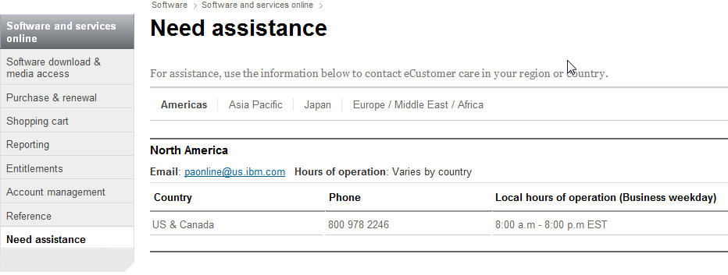
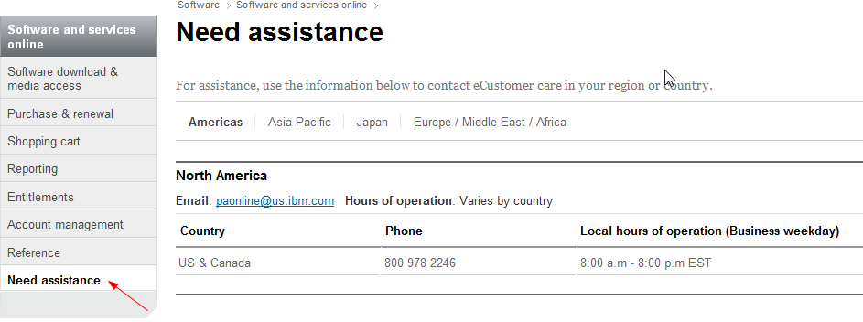
How to obtain PA help this shows NA –chg to EMEA or APO if needed

Slide 56
Working with IBM Remote Technical Support
Welcome to IBM

Slide 57
IBM Support Process
Open a Service Request (PMR)
-Route SR to product experts
-Entitlement check
Workaround/New solution
Source identification:
-Workarounds & solutions
-Problem recreation
-Deep technical skills
-Create APARs
-Interface to Level 3
Creates/
Delivers fixes
-Code based team
-Create fixes and fix packs
-Create debug modules
-Skilled in their components, not experts on entire product
Open/Update/Monitor
-Find known answers
-Help collect MustGather
-Educate clients on self-help
-Broad usage based skills
-Language support
Fastest path to resolution
*Preferred Method
*Service Request Tool via Support Portal
(Sev 1-4)
Voice support available (Sev 1 only preferred)
Level 1: Rediscovery
Level 2:
Problem Determination
Level 3:
Development
OR
Notes:
When you need help, you can open a PMR yourself using the SR tool, or you can call the local IBM Call Center.
The Call Center documents your problem and it’s business impact. The Call Center uses keywords in your problem description to route your call to Level 1 support product experts. The call center staff does not have technical product skill.
Level 1 will then do what’s called Rediscovery. Level 1 is a collection of certified professionals who can help you find published answers to your problem. If there are no published answers, they can help you collect the necessary MustGather data and time permitting, educate you on the available self-help capabilities at IBM.com. If Level 1 is a separate organization, you would then be transferred over to Level 2. Products that do not have level 1 will have Rediscovery and Problem determination performed by level 2.
Level 2 now works with you to create work-arounds and find new solutions to your problem. If a new solution is created, it can be captured in a technote and published to the external Web. If the problem appears to require some sort of code change, Level 2 will engage the appropriate Level 3 team and create the APARs needed to track the problem.
Now on to Level 3…each product has multiple change teams. The change teams have a deep understanding of specific components and can create debug modules, test fixes, and if necessary, publish a test fix. In most cases, test fixes would then be collected and used to create a tested Fix Pack which would then be published to the Web.
It is in your best interest to work with Level 2 as an interface because they can help coordinate the work of multiple Level 3s to help solve your problem.
So how can you save time? You first start by opening your PMR electronically using the SR tool ….this lets you bypass the Call Center.
By documenting the problem symptoms, what has recently changed, and your actions regarding search and collecting data, you can minimize your time with Level 1. After that, you can interact directly with the correct Level 2 team using SR tool
Finally, you have the ability to view updates from Level 3 through your PMR using SR tool
57

Slide 58
Setting Severity Levels
1
CRITICAL BUSINESS IMPACT: this condition requires an immediate solution
Initial Response Goal: within 2 hours
2
SIGNIFICANT BUSINESS IMPACT: program is usable but severely limited
3
SOME BUSINESS IMPACT: program is usable but less significant features impacted
MINIMAL BUSINESS IMPACT: problem causes little impact or a reasonable workaround is in place
4
Other platforms Initial Response Goal: within 2 business hours
Other platforms Initial Response Goal: within 2 business hours
Other platforms Initial Response Goal: within 2 business hours
Customer must be available to work Sev 1’s 7 days a week/24 hours a day
System Z - Initial Response Goal: within 4 business hours *
System Z - Initial Response Goal: by the end of the next business day
System Z - Initial Response Goal: by the end of the next business day
* Business hours are from 09:00 AM to 5:00 PM local time for the country where the software is licensed.
Notes:
58

Slide 59
Working with IBM Support
PMR assigned to a local Support Analyst based on PMR country code.
Update via SR tool
  – Generates notification to support team
Request call back if you want us to call you.

Slide 60


Escalation Options
1
Check Severity Level
2
Contact Duty
Mgr
3
Formal Complaint
Check the severity level of the Service Request (PMR) and raise if needed. Update the business impact if it has changed, and of course, indicate system down if that is the case
1
CRITICAL BUSINESS IMPACT
2
SIGNIFICANT BUSINESS IMPACT
3
SOME BUSINESS IMPACT
MINIMAL BUSINESS IMPACT
4
Call the local contact telephone number and ask for the duty manager (DM).
Worldwide contacts: http://ibm.com/planetwide/
Notes:
60

Slide 61

IBM Remote Technical Support Overview
Included:
Not included:
Voice and electronic access to report a defect and “how to” questions
View and manage problem status on the Internet
Worldwide infrastructure: support in native languages & time zones
Coverage
  Severity 1 Problem: 24/7 coverage
  Severity 2-4 Problems: normal business hour coverage
  On-site support
  Network design
  Support for products past their End of Support (EOS) date
  Analysis of customer’s program code (i.e.: exits, applications)
  Data/database design & recovery
  Diagnosis & analysis of non-IBM products
  Application or product integration help
  Performance, tuning, or a health check
Notes:
For appliances, refer to your hardware support agreement
Short duration problems involving
Installation
Usage (how-to)
Specific usage/installation questions for documented functions
Product compatibility and interoperability questions
Technical references to publications, such as redbooks or manuals
Assistance with interpretation of publications
Providing available configuration samples
Planning information for software fixes
IBM database searches
Subscription and Support and Support Line are not structured to address everything -- the following are examples of areas that are beyond their scope:
Analyzing performance
Writing, troubleshooting or customizing code for a client
Answering extensive configuration questions
Recovering a database, or data recovery
Consulting
Interpretation or triage of customer or third party generated defect scanning reports
Most of these types of situations require some form of Advanced Support Offering. For further information about these services please contact your IBM Representative who can help direct you to resources who can discuss your needs.
61

Slide 62
IBM Software Accelerated Value Program
Proactive Support
  – Planning, deployment, upgrades, and migration
  – Deployment planning and progress management
  – Potential problem identification and prevention
  – Early notification of potential critical situations
  – Best practice sharing
  – Researches and communicates new technotes, skills, products and features applicable to your business
Knowledge and Skill Sharing
  – On site technical activities
  – Staff coaching, workshops, and guidance
  – Invitations to remote briefings and summits
Productivity Enhancement
  – Assistance with problem management, including priority escalation, reporting on support
  issues, and personalized trend analysis.
URL: http://www-01.ibm.com/software/support/acceleratedvalue/index.html

Slide 63
IBM Lifecycle Policy
Goal: To give customers a reasonable amount of time to purchase, install, productively use, and migrate to the next product release.
A minimum 5 year support period for all products (version / release level) from general availability
A minimum 12 months notice to customers of a product being withdrawn from support via announcement letter.
Product lifecycle information is available at :-
April and September are the only two months of the year for products to be withdrawn from support
All components in a product or solution bundle are supported until the bundle is withdrawn from support
http://www.ibm.com/software/info/supportlifecycle/
Notes:
ICA (MLC) products follow the same guidelines but there is no published policy

Slide 64
Additional Resources
Welcome to IBM

Slide 65
Questions?
Should you have any non-product questions or you are not receiving a response through
  other avenues, please contact us at any time and we will contact you during local business
  hours. The ECM Client Care team is here to help!
iscare@us.ibm.com
The copy of this Support Client Experience presentation will be emailed to all participants of the meeting.
The ECM Client Care team is managed by Jeff Thompson. Jeff can be reached at
jefft2@us.ibm.com or 720-396-0250
NOTE: Technical Support Specialists are not able to view your registration information or
your website view

Slide 66
Additional resources:
IBM Electronic Support
  http://www-01.ibm.com/support/electronicsupport/
eSupport Channel:
  http://www.youtube.com/user/IBMElectronicSupport?feature=watch
IBM Support Handbook:
  http://www14.software.ibm.com/webapp/set2/sas/f/handbook/home.html
IBM Support Portal overview:
  http://publib.boulder.ibm.com/infocenter/ieduasst/imv1r0/index.jsp?topic=/com.ibm.iea.selfassist/selfassist/1.0/portal/IBMSupportPortalOverview/IBMSupportPortalOverview.html
Passport Advantage:
  www.ibm.com/software/passportadvantage
Instructions for managing your Contacts on Passport Advantage:
  http://www-01.ibm.com/software/lotus/passportadvantage/pa_contacts.html
Service Request (SR) tool:
  http://www.ibm.com/support/servicerequest/
Additional Service Request information:
  https://www-946.ibm.com/support/servicerequest/help/srHelp.action
Instructions for managing your Contacts on the Service Request site:
  https://www-946.ibm.com/sr/help/stc.html
Fix Central:
  http://www.ibm.com/support/fixcentral

Slide 67
Glossary of Terms
APAR - Authorized Program Analysis Report (reported software defect)
IBM - International Business Machines
IBM ID - IBM web id or web id - necessary to access online services
ICN - IBM Customer Number
KB - Knowledgebase
PA - Passport Advantage
PMR - Problem Management Report
POE - Proof of Entitlement
PSC - Primary Site Contact or Primary Contact
S&S - Subscription and Support
Site ID - identifier of site within an organization
STC - Site Technical Contact
SR - Service Request

