Slide 1
Neil Sanderson

Slide 2
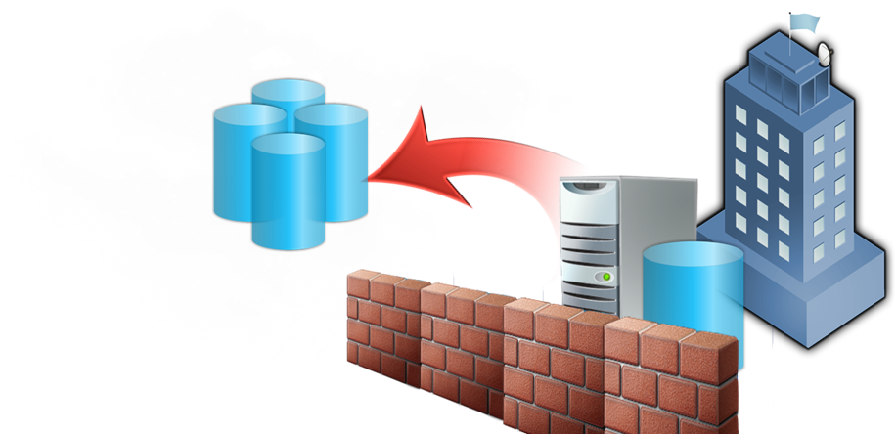
DYNAMIC IT Aligned, adaptable, efficient
DATACENTRE
APPLICATIONS
Move from physical to logical
Managed by models & policy
State-aware, self-healing
Available, secure and realtime
Federated, composite, service-based
Connected and user focused
On-premise, off-premise, hosted
Developer-to-operations lifecycle

Slide 3
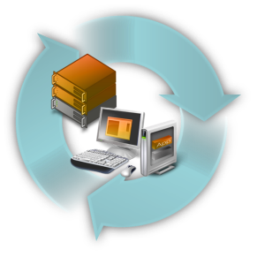
Microsoft Virtualisation Themes
Desktop to datacentre
Familiar platform and tools
Management
Accelerate deployment
Full range of products & solutions
Fits with existing skills and investments
Physical and virtual
Broad skilled partner ecosystem
Integrated platform
Breadth of choices
Cross hypervisor, server + desktop
Licensing, interoperability, support

Slide 4
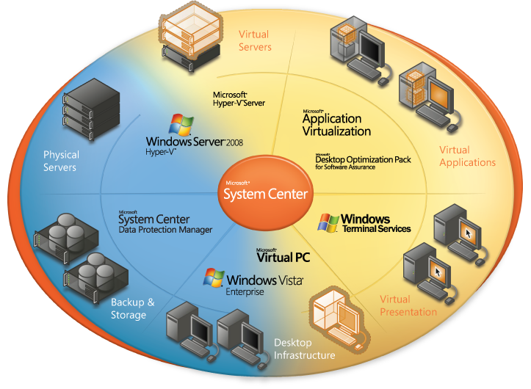
Integrated virtualisation
Notes:
Why should you choose Microsoft for your virtualization needs? Microsoft provides a comprehensive, end-to-end toolset for creating, provisioning, managing, and securing both the virtual and the physical infrastructures of your organization, including the management of third-party virtualization solutions.
Using familiar interfaces and common management consoles, an environment based on Microsoft technologies will deliver the promised cost, service level, and agility benefits while reducing system complexity that can result from disparate point solutions. Your IT organization can harness the power of virtualization across the enterprise while simultaneously improving the efficiency and effectiveness of your operations.

Slide 5
Server virtualisation technologies
Microsoft System Center
Operations Manager 2007
Configuration Manager 2007
Data Protection Manager 2007
Virtual Machine Manager 2007
Host Windows, Linux, and Other Virtual Machines
Hyper-V Hypervisor Built-In
Windows Server 2008
Notes:
Microsoft provides a variety of discrete technologies that come together to solve datacenter challenges. The foundation for these is Windows Server 2008, which includes the Hyper-V hypervisor operating system feature. The hypervisor is installed by the familiar administrative task of configuring a server role. Windows Server 2008 was designed for interoperability, and Hyper-V was specifically engineered to be a great hypervisor for Windows, Linux, and UNIX guests.
Unified and consistent management is provided by the System Center family of products. Virtual Machine Manager provides the administrative console for provisioning and maintaining virtual machines. Operations Manager monitors physical and virtual environments and provides guidance to optimize IT operations. Configuration Manager allows the quick provisioning of physical servers, along with automated patching for physical and virtual environments. Data Protection Manager provides the foundation for backup, restore, and disaster recovery, and through a single tool allows IT to back up virtual machines and their internal workloads.

Slide 6
Virtualization Management in System Center
Virtualization Management Capabilities | Virtual Machine Manager | Operation Manager | Configuration Manager | Data Protection Manager
Server consolidation through virtual migration | X
Virtual machine provisioning and configuration | X
Server health monitoring and management |  | X
Performance reporting and analysis |  | X
Patch management, software upgrades |  |  | X
Virtual machine backup and restore |  |  |  | X
Disaster recovery |  |  |  | X
VM
VM
VM
VM
VM
VM
VM
VM
VM
VM
VM
VM
VM
VM
VM
VM
VM
VM
VM
VM
VM
VM
VM
VM
VM
VM
VM
VM
VM
VM
VM
VM
VM
VM
VM
VM
VM
VM
VM
VM
VM
VM
VM
VM
VM
VM
VM
VM
Notes:
Virtualization technology is only a portion of the virtualization solution. All datacenter operations require management tools for both the physical and the virtual layers. Datacenters also require the provisioning of software, as manual provisioning is not adequate to meet the needs of agile, cost-conscious businesses. Further, datacenters require operational monitoring, alerts, and problem mitigation. Finally, datacenters require quick and granular backup and recovery, scaling to full disaster recovery scenarios as necessary. Microsoft provides this critical functionality through the System Center suite of products.

Slide 7
Interoperability Heterogeneous Environments
Heterogeneous Guests
Windows
Linux
UNIX
Heterogeneous Hypervisors
Hyper-V
ESX
Xen
ESX
Multiple hypervisors in one pane of glass
Standard process over disparate technology
ESX, Hyper-V, and Xen will coexist
Management
Cross platform ops management: physical and virtual
Notes:
CIOs report that, more and more, datacenters are using virtualization technology from multiple vendors. The main vendors – Microsoft, Citrix, and VMware – all have strengths that may make one more appropriate for a specific scenario. In addition, datacenters that already use virtualization are likely using VMware but are eager to introduce competing technologies that promise cost savings and unified management.
To address this need, Microsoft has focused on interoperability. Microsoft supports Windows, Linux, and UNIX guest operating systems to ensure that an organization can virtualize its existing workloads onto a single hypervisor technology. Microsoft is also leading the industry with management support for disparate hypervisors, allowing organizations to choose the best hypervisor technology for specific workloads and to manage them through a single pane of glass.
To meet the needs of customers, Microsoft has formed strategic partnerships with Citrix and certain open source projects, and has built interoperability to make certain that ESX operates as a first-class hypervisor in Virtual Machine Manager.

Slide 8
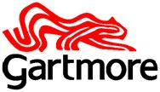
6. What are customers doing?
85% reduction in server hardware requirement
“Using System Center Virtual Machine Manager 2008, we’ve been able to reduce new-server provisioning time from 16 hours to about 3 minutes.”
Reduced data center costs, repurposed power capacity to install a larger storage area network, and improved disaster readiness.
New commodity services through faster provisioning
Faster simpler deployment of applications, increased innovation in use of new applications
Warwickshire County Council

Slide 9
Customer Size: 1000 employees
Organization Profile
Gartmore is an asset management firm that provides investment products and services to investors worldwide. Gartmore manages over U.S.$43 billion in assets.
We were always concerned about creating a single point of failure, but with Windows Server 2008 clustering and Hyper-V, we can take the consolidation ratio much higher.
Clive Williams Head of Enterprise Technical Services, Gartmore
Reduced server and electrical costs
More efficient IT management
Increased availability
Cost-effective branch-office
Notes:
http://www.microsoft.com/casestudies/casestudy.aspx?casestudyid=4000001827
Software and Services Microsoft Exchange Server 2007 Windows Server 2008

Slide 10
Customer Size: 2500 employees
Organization Profile
Slough Borough Council (Slough BC) is the local authority for the borough of Slough, England, 22 miles west of London. The council employs approximately 2,500 people and serves a population of 122,000.
We look forward to integrating System Center Operations Manager 2007 and System Center Virtual Machine Manager 2008 to get a better picture of our combined physical and virtual infrastructure.
Chris Wintermute Technical Infrastructure Manager, Slough Borough Council
Growing room, hardware savings
Efficient, proactive IT management
Capacity to support new services
Increased server utilization
Notes:
http://www.microsoft.com/casestudies/casestudy.aspx?casestudyid=4000001827
Software and Services Microsoft Exchange Server 2007 Windows Server 2008

Slide 11
Customer Size: 20000 employees
Organization Profile
Warwickshire County Council ICT Development Service provides services to around 5,000 workstations in more than 250 schools.
It was clear from the start that Microsoft understood what we wanted to achieve on behalf of teachers and pupils. This gave us the confidence to authorise a proof-of-concept deployment.
Chris Page, Technical Development Manager, Warwickshire ICTDS
dramatically reduced the cost of onsite software, deployment, and maintenance, while increasing data security.
Notes:
http://www.microsoft.com/casestudies/casestudy.aspx?casestudyid=4000001827
Software and Services Microsoft Exchange Server 2007 Windows Server 2008

Slide 12
Customer Size: 270 employees
Organization Profile
London-based NetBenefit is a managed hosting company that has been providing flexible hosting services in the United Kingdom for over 12 years.
Virtualization extends the range of services that we can offer which allows us to more fully meet our customers’ needs.
Jonathan Robinson, Chief Operating Officer, NetBenefit
Expanded customer services
Easier server administration
Reduced data center costs
Enhanced security
Notes:
http://www.microsoft.com/casestudies/casestudy.aspx?casestudyid=4000001827
Software and Services Microsoft Exchange Server 2007 Windows Server 2008

Slide 13
Microsoft Assessment and Planning: MAP Tool
MAP
Windows Server 2008
Other Products
Hyper-V
Virtual Server 2005 R2
Windows Vista
2007 Microsoft Office
Microsoft
Application
Virtualiz-ation
Terminal Services
System Center VMM
Integrated portal with automated tools
Agent-less inventory of clients, servers, applications, devices and roles
Technology migration and readiness assessment
Identification of virtualization candidates
www.microsoft.com/MAP
Notes:
In order for a successful IT project rollout to become a reality, understanding the network environment is key. The MAP tool works as a remote inventory engine. By simply installing MAP on a single desktop or server, connecting it to the IT network, and confirming the correct credentials, you will be able to leverage WMI and other protocols to find and assess computers on the network. MAP can generate technology-specific assessments and recommendation reports in both Microsoft Word and Microsoft Excel.
Some of the features of the MAP tool include:
Integrated portal with automated tools and guidance from desktops to servers
Agentless inventory of clients, servers, applications, devices, and roles
Technology migration, readiness assessment, and proposal generation
Additionally, the MAP tool provides:
Hardware and device compatibility for Windows Vista, Windows Server 2008, and Microsoft Office System 2007
Server virtualization candidates for consolidation with Hyper-V and Virtual Server 2005 R2
Infrastructure assessment for environment to leverage Microsoft Application Virtualization (formerly SoftGrid)

Slide 14
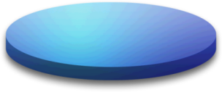
Microsoft Integrated Virtualization ROI Tool
What is it?
Lets you enter your current hardware, OS, and workload configuration and estimate consolidation savings.
How can the ROI Tool help me?
The benefits of using the ROI Tool are:
Determine consolidation benefits and ROI
Based on your current infrastructure, including workloads
Provides comparison to other virtualization vendors
All-inclusive software and hardware costs
Access the ROI Tool here: http://www.microsoft.com/virtualization/roitool
Notes:
The Microsoft Integrated Virtualization ROI Tool is designed to help organizations make the business case for virtualization solutions and easily compare the cost of Microsoft’s solutions to competing technologies.
The ROI Tool can assist organizations in rapidly determining their particular ROI with Microsoft’s virtualizations solution. The tool allows you to enter information about the business’s current infrastructure, including hardware, operating systems, and workloads. The tool assists in determining the virtualized infrastructure and estimating the cost to implement it, taking into consideration hardware costs and software licensing in order to provide the most comprehensive pricing. The ROI Tool also compares competitive products to illustrate the cost savings to your business of the Microsoft solution.

Slide 15
Why Microsoft?
It’s Windows
Familiar, integrated
Existing tools, skills, and hardware
Full 360º View
Servers, applications, presentation, desktop, and storage
Integrated Management
Manage physical and virtual with one set of tools
Best Value
Cost effective licensing, fast deployment, rapid ROI
Interoperability
Interoperable products
Strong partnerships
Notes:
Why should you choose Microsoft for your virtualization needs? Microsoft provides a comprehensive, end-to-end toolset for creating, provisioning, managing, and securing both the virtual and the physical infrastructures of your organization, including the management of third-party virtualization solutions.
Using familiar interfaces and common management consoles, an environment based on Microsoft technologies will deliver the promised cost, service level, and agility benefits while reducing system complexity that can result from disparate point solutions. Your IT organization can harness the power of virtualization across the enterprise while simultaneously improving the efficiency and effectiveness of your operations.

Slide 16
Questions

Slide 17
7. Why is virtualisation <10%?
Cost
Complexity
Management
Virtual Sprawl
Single Point of Failure
Software Licensing
Hardware
Performance
Political
Security Concerns

Slide 18
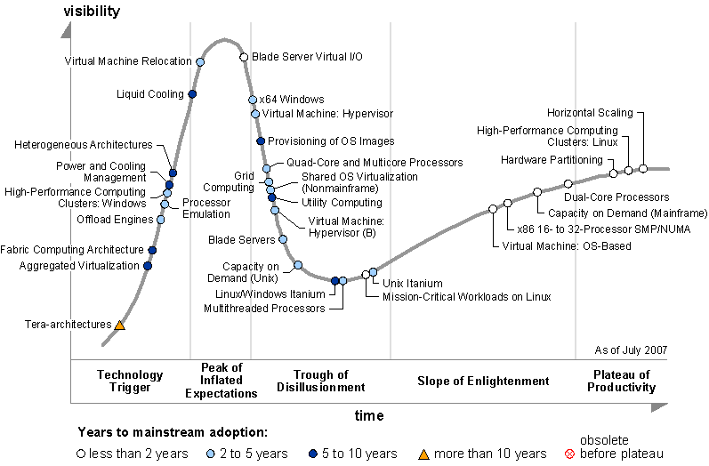
1. The game is only starting
virtualisation Adoption
x86 servers used for virtualisation
Source: IDC Sep 2006
virtualisation adoption continues to rise: % of x86 servers virtualized expected to grow to about 14% in 2010
Notes:
Shipments of virtualized physical servers in Western Europe is forecasted to rise at a CAGR of 55% during 2006-11 (IDC)
worldwide x86 server shipments will be reduced by a 7% compound annual growth rate from 2007 through 2012.

Slide 19
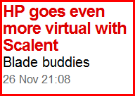
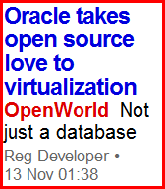
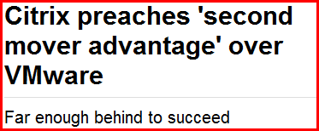
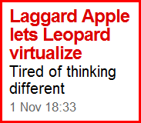
2. New entrants – more choice

Slide 20
4. How to make virtualisation succeed
Virtualisation as part of IT infrastructure
Integrate the management of virtual servers with physical servers
Keep same disciplines of security, continuity and recovery to maximise business availability
Drive the necessary cultural changes for effectively managing resources in a virtual environment
Notes:
Develop a cohesive, holistic virtualisation strategy across the IT infrastructure
Design your virtualisation strategy with an end-to-end structure to minimise system complexity and capture maximum benefit
Create a continuous consolidation framework for ongoing optimisation
Employ single-purpose servers to simplify management and provide optimal isolation, conflict reduction and resource usage
Integrating the management of virtual and physical computers with policy-based tools to reduce system complexity
Reduce system complexity by managing virtual server infrastructure in a common console
Leverage existing knowledge on server administration — ensure that the tools for managing virtual resources don’t create knowledge gaps
Automate change management with advanced policy-based tools
Leverage advanced security, continuity and recovery opportunities to maximise business availability
Maintain snapshot-based back-up to provide more robust restore capability, and to provide tool for forensic analysis
Spread mission-critical workloads over multiple servers to distribute risk, avoiding interruption in the event of a hardware failure
Isolate high-risk workloads from high-vulnerability workloads and underlying OS
Drive the necessary cultural changes to effectively manage resources in a virtual environment
Institute discipline around resource planning and virtual machine creation to prevent uncontrolled sprawl
Strive for commonality among management processes and tools
Recognise that all resources become data files in a virtual environment; capture the organisational best practices and skills for data management
Develop a framework and understanding for resource sharing across different sponsor organisations
20

Slide 21
5. Benefits?
Control costs
Optimize utilisation of servers
Improve Availability
Disaster recovery capabilities
Drive Agility
Dynamic resource allocation
Faster provisioning of services / workloads to support business growth and meet SLAs
Streamline server maintenance, and isolate risk
Enable access to any desktop application anywhere
Reduce costs: hardware, power, space
Reduce application compatibility conflicts
Reduce overall system complexity

